Slide 1

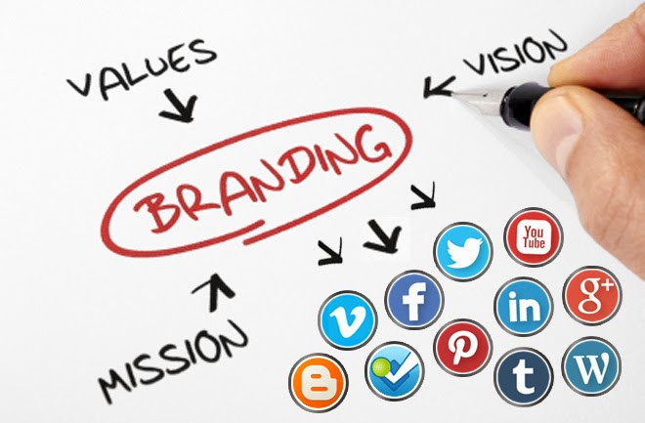
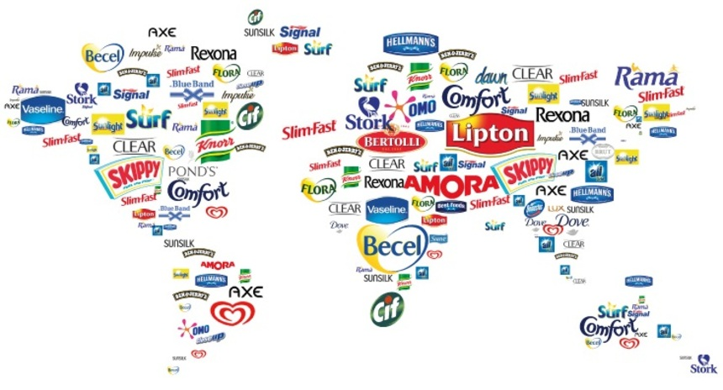
Brand image in business

Slide 2
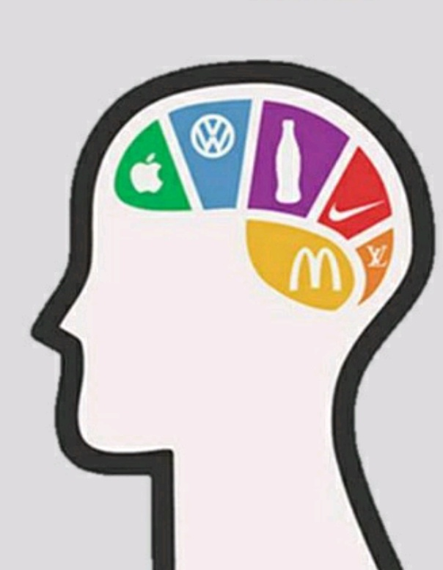
WHAT IS A BRAND IMAGE?
Brand Image is how or what the customers think of a brand.
It can be defined as the perception of the brand in the minds of the customers. This image develops over time. Customers form an image based on their interactions and experience with the brand.
It is an aggregate of beliefs, ideas, and impressions that a customer holds regarding the brand. A brand can be perceived differently by different customers. Hence, the formation of a consistent brand image is a huge task for any business.

Slide 3
Importance of brand image
More profits as new customers are attracted to the brand. Easy to introduce new products under the same brand.
Boosts the confidence of existing customers. Helps in retaining them. Also helps in improvising Business-Customer relationship. New product ranges will be recognized as being similar to existing product ranges i.e., Lower costs in promotion.
Increases consumers trust. Customers are attracted to brands that share similar values with them. When you showcase what you value through branding, customers will develop an emotional connection to you.

Slide 4
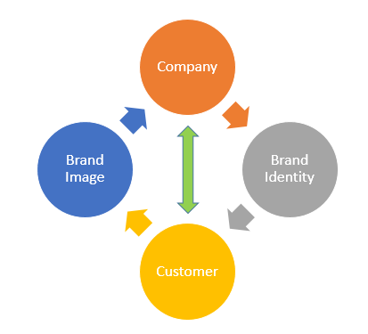
Factors Contributing to Brand Image
1. Quality of the Product/service
2. Usability of the Product/service
3. Perceived value
4. Some association like a celebrity with positive impact
5. Durability

Slide 5
Components of brand image
Price, packaging, user imagery, etc.
Functional(often related to physiological needs), experiential(what it feels like to use the product) and symbolic(i.e., a need for social approval or self-esteem).
Consumer's overall evaluations of a brand.
ATTRIBUTES
BENIFITS
BRAND ATTTITUDES

Slide 6
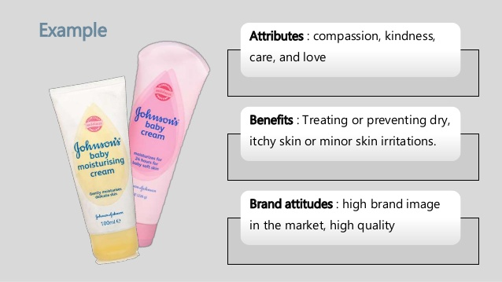
Example:
Attributes: Compassion, Kindness, Care and Love.
Benefits: Treating or preventing dry, itchy skin or minor skin irritations.
Brand attitudes: Highly reliable product, trusted quality.

Slide 7
Some noteworthy brands
The brand image can be understood with BMW example. BMW as a car is associated with luxury, power and status symbol. The brand image of BMW is positive in minds of target audience and the image is of a brand which will raise their status in society and would be seen as absolute parameter of one's success.
Another example can be seen for Starbucks. It is considered a place which is associated with warmth, comfort and good coffee. The brand image for Starbucks is that of a comforting brand. People associate memories with such brands.
Fashion brands: GUCCI, COTTON CANDY, H&M, etc.

Slide 8


Personal branding for social workers
Social workers are using branding to establish relationships and present an authentic self.
What people are passionate about plays a role in what’s reflected in the brand. Also, all of these social workers have used various tools to communicate, such as publishing books, podcasts and research, creating online communities and Twitter chats, and positioning to be included in media articles.
All of these activities play a role in communicating their expertise and raising their visibility.
Example:

Slide 9

Foundation for a Strong Brand Image
1. Identify Key Audiences: Be very specific when defining your audiences.
2. Determine Critical Business Goals: Building a brand image knowing your short-term and long-term business goals.
3. Define Brand Persona: Persona should appeal to customers and articulate your most important differentiators and product benefits.
4. Develop Key Messaging: document your key messages and align them with your audiences.

Slide 10
Steps for Solidifying Brand Image
1. Public Relations: PR disseminates your key messages and company news in online blogs, trade publications and news outlets. By positioning your company as a thought leader and expert source on breaking news and trends, PR can improve your brand image and raise awareness.
2. Content: Content is the fuel that drives integrated PR and digital marketing activities. To elevate your brand profile, you’ll need to deliver a steady stream of white papers, contributed articles, blog posts and other rich content assets to target audience segments.

Slide 11

STEPS FOR SOLIDIFYING BRAND IMAGE
3. Social: Social media is a valuable tool for sharing information relevant to your industry and interacting with customers and influencers in your field. A robust social media presence can significantly increase website traffic and enhance your image with both new and existing customers.
4. Search:Search Engine Optimization (SEO) is a tactic that improves your company’s ranking on popular search engines like Google. To make an impact with key audiences, you’ll need to rank well for specific keywords and key phrases, increasing the amount of traffic to your company website and other digital assets.

Slide 12

Thank you!
Suraj m(1336)
Usha u(1337)
Vaishnavi b(1338)
Venkatesh d(1339)
Rajesh m(1340)

